Slide 1
ILS Z-534: Final Project Yelp Dataset Challenge
TEAM 3:
Giridhar Gomatom
Rohit Ingle
Manasa Patibandla
Megha Redkar

Slide 2
Task 1

Slide 3
Algorithm
noSQL
JSON files
CSV file format
ARFF file format
MEKA
ARFF file format
Training dataset
Testing dataset

Slide 4
Classifier for Task 1
Naïve-Bayes Algorithm
Training dataset
MULAN
Testing dataset
Predictive model
output

Slide 5
Experiment Settings
Stemming
Stop Words
Nouns
Apply Multi-label Classifier in MEKA using Naive Bayes Classifier from WEKA

Slide 6



Evaluation Metrics for Task 1
Hamming Loss
Accuracy

Slide 7
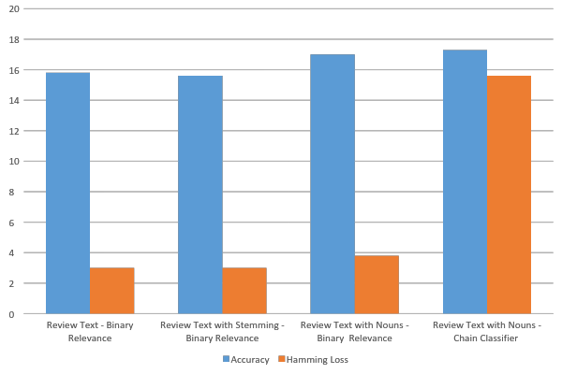
Results

Slide 8
Task 2 Predicting User Ratings from Reviews

Slide 9
Algorithm
Data Preprocessing
JSON to CSV
CSV to ARFF
Sampling
Feature Selection
Stemming
Stop Word Removal
POS tagging
Bigrams
Train Classifier
Multinomial Naïve Bayes
Linear Logistic Regression
Evaluation
Accuracy

Slide 10
Data Analysis
Reviews.json
5-Star
400k
4 – Star
340k
3 – Star
160k
2 – Star
100k
1-Star
100k
Total Instances used – 100000
Tasks:
Dataset-1 : Baseline Accuracy – 20%
Dataset-2: Baseline Accuracy – 50%
Tools Used: Weka, Stanford NLP Toolkit.
Testing Scheme: 10-fold cross validation on the dataset.

Slide 11
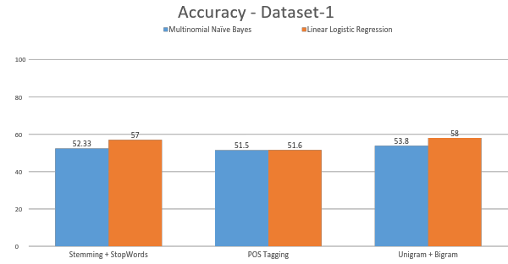

Slide 12
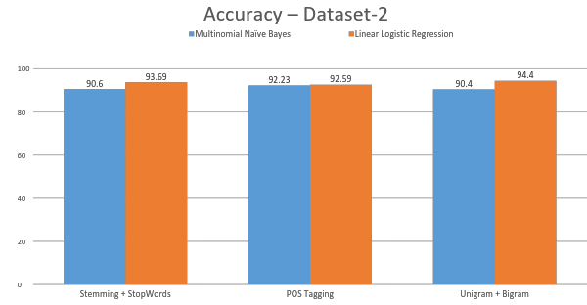

Slide 13
Future Work
Implement:
TF-IDF Feature Selection
SVM classifier
Build a model capable of predicting fake/bad user reviews.

Slide 14
Thank you!

